Slide 1
Object-oriented Programming
Week 12 | Lecture 1

Slide 2
STL (Standard Template Library)
STL is a key feature of C++
It provides general-purpose, templatized classes and functions that implement many popular and commonly used algorithms and data structures e.g. Stack, Queue etc.
Because the STL is constructed from template classes, the algorithms and data structures can be applied to nearly any type of data

Slide 3
Containers
Containers are templatized classes present in the STL
Each container class defines a set of functions that may be applied to the container e.g. Stack class provides functions for push and pop operations

Slide 4
Algorithms
Algorithms provide the means by which we can manipulate the contents of containers
Their capabilities include initialization, sorting, searching, and transforming the contents of containers

Slide 5
Iterators
Iterators are special objects that act, more or less, like pointers
Using Iterators, we can cycle through the contents of a container just like a loop-pointer cycles through an array

Slide 6
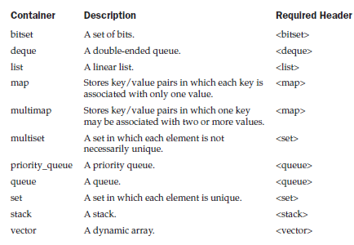
Container Classes in STL

Slide 7
Vectors
The vector class simply provides a dynamic array i.e. an array that can grow as needed
Vectors allocates memory when needed
Although a vector is dynamic, we can still use normal array syntax to access its elements

Slide 8
Vectors
// create zero-length int vector
vector<int> iv;
// create 5-element char vector
vector<char> cv(5);
// initialize a 5-element char vector
vector<char> cv(5, 'x');
// create int vector from another int vector
vector<int> iv2(iv);

Slide 9
Functions in Vector Class
Some of the most commonly used member functions are size( ), begin( ), end( ), push_back( ), insert( ), and erase( )
Many other functions and their overloaded versions are also available

Slide 10
Example
int main()
{
vector<char> v(10);
cout << " Size = " << v.size() << endl;
for(int i=0; i<10; i++) v[i] = i + 'a';
cout << " Current Contents:\n";
for(int i=0; i < v.size(); i++) cout << v[i] << " ";
for(int i=0; I < 10; i++) v.push_back (i + 10 + 'a');
cout << "\n Size now = " << v.size() << endl;
cout << " Current contents:\n";
for(int i=0; i < v.size(); i++) cout << v[i] << " ";
}

Slide 11
Accessing a Vector Through an Iterator
int main()
{
vector<char> v(10);
vector<char>::iterator p;
p = v.begin();
int i = 0;
while ( p != v.end() ) { *p = i + 'a';
p++;
i++; }
}

Slide 12
Inserting and Deleting Elements in a Vector
int main()
{
vector<char> v(5, 'x');
vector<char>::iterator p;
p = v.begin();
p = p + 2;
v.insert(p, ‘y’); p++; v.erase(p);
}

Slide 13
Storing Class Objects in a Vector
Vectors can store any type of objects (not just built-in types), including those of classes that we create
Example:
vector<MyClass> v;

Slide 14
Lists
The list class supports a bidirectional, linear list
Unlike a vector, which supports random access, a list can be accessed sequentially only
Since lists are bidirectional, they may be accessed front to back or back to front

Slide 15
Example
int main()
{
list<int> lst;
for(int i=0; i<5; i++) lst.push_back( i );
for(int i=0; i<5; i++) lst.push_front( i );
// 4 3 2 1 0 0 1 2 3 4
list<int>::iterator p = lst.begin();
while(p != lst.end())
{
cout << *p << " ";
p++;
}
}

Slide 16
Using pop_front() and pop_back()
int main()
{
list<int> lst;
for(int i=0; i<5; i++) lst.push_back( i );
// 0 1 2 3 4
lst.pop_front( );
// 1 2 3 4
lst.pop_back( );
// 1 2 3
}

Slide 17
Common Operations on Lists
We can sort a list:
lst.sort();
We can reverse the contents of a list:
lst.reverse();
We can splice a list:
lst1.splice(p, lst2);

Slide 18
Exercise
Modify the generic list class from the previous lecture so that elements can only be added from the front end while they can only be deleted from the rear end
Add a splice function for your generic list class

